Slide 1
Group 4:
Raghav Chopra (C0772292)
Topic: Interfacing of Beaglebone black with Limit switch

Slide 2
Contents
Task objective
Components required for interfacing
Introduction of Beaglebone black
Pin description of beaglebone black
Specifications of Beaglebone black
Introduction of limit switch
How does a limit switch work?
Advantages and limitations of limit switch
Interfacing of Beaglebone black and limit switch
Code
References

Slide 3
Task objective
The main function of this task is to interface beaglebone black with limit switch.
To establish the proper hardware connections so that both components communicate with each other.
To execute the code perfectly in order to get the correct output.

Slide 4
Components required for interfacing
Hardware requirements:
Beaglebone black
Limit switches
Jumper wires
USB cable

Slide 5
Software requirements:
Debian image for Beaglebone black
Linux operating system
Gcc compiler
GNU nano editor

Slide 6
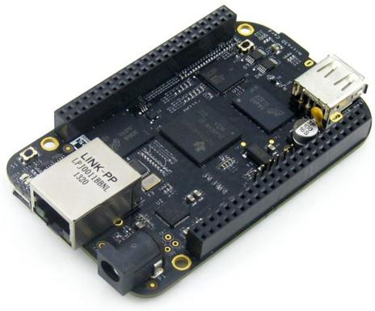
Introduction of Beaglebone black
The Beaglebone black is a low cost, open hardware and expandable computer launched by a community of developers from Texas Instruments. It consists of large amount of input and output pins and also it has on board interfaces which enables the devices to connect smoothly with the beaglebone black.

Slide 7
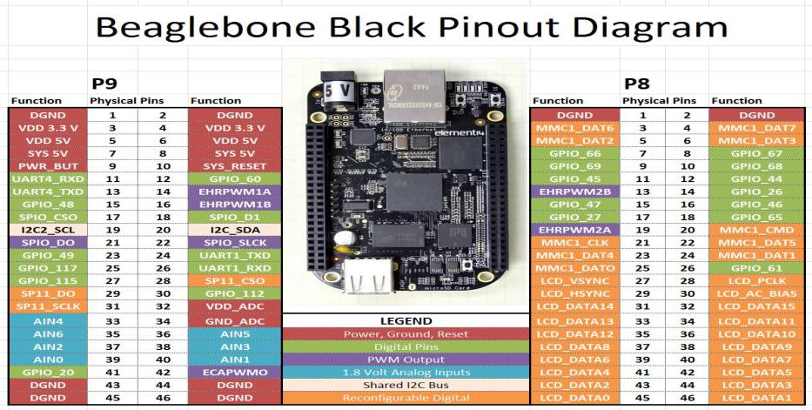
Pin description of Beaglebone black

Slide 8
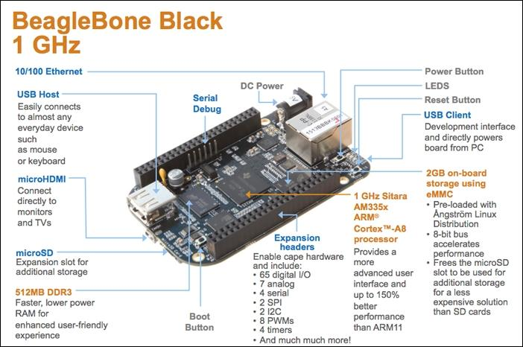
Specifications of Beaglebone black

Slide 9
Technical specifications
Processor -- Sitara AM3358BZCZ100 1 GHz 2000MIPS
SDRAM memory -- 512MB DDR3L 800 MHz
On board flash -- 4GB, 8-bit Embedded MMC
Debug support -- Optional Onboard 20-pin CTI JTAG, serial header
Power source -- miniUSB, USB and 5V DC External
PCB -- 3.4” x 2.1” 6 layers
Indicators -- 1 Power, 2 Ethernet, 4-User controllable LED’s
HS USB-2.0 Client port -- Access to USB0, Client mode via miniUSB

Slide 10
Cont.
HS USB 2.0 Host port -- Access to USB1, Type A socket
Serial port -- UART0 Access via 6-pin 3.3V TTL header
Ethernet -- 10/100, RJ45
SD/MMC Connector -- microSD, 3.3V
User input -- Reset Button, Power Button, Boot Button
Video out -- 16b HDMI, 1280 x 1024 (MAX)
Audio -- Via HDMI interface, Stereo
Expansion Connectors -- Power 5V, 3.3V, VDD_ADC (1.8V), 3.3V I/O on all signals, McASP0, SPI1, I2C, GPIO(69MAX), LCD, MMC1, MMC2, 4 timers, 4 serial ports, CAN0, XDMA Interrupt, Power button, Expansion board ID.

Slide 11
Features of Beaglebone black
Large number of GPIO I/O pins
High performance computing experience
Supports deterministic execution hardware via dedicated processing unit
Robust and wide options for connectivity
Open source hardware technology- it gives options to manufactures to integrate ARM technology for developing cloned beaglebone development boards.
Open source software technology- it provides options to install wide range of android and linux based operations systems.

Slide 12
Applications of Beaglebone black
Robotics
Micro controller
Automation
IOT
AWS
Bluetooth connectivity projects

Slide 13
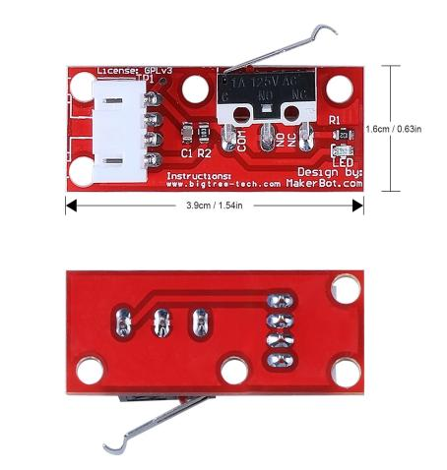
Introduction of Limit switch
Limit switches are used to detect the presence of the object and to monitor the movement of that object. In our project, we are using limit switches to detect the status of the garage door and if that door opens too long and we can use limit switches manually to close the door.

Slide 14
How does a limit switch work?
It is used in industrial applications is an electromechanical device that consists of a mechanical actuator linked to a series of electrical contacts. When an object comes in physical contact with the actuator, the actuator movement results in the electrical contacts within the switch to either open or close their electrical connection.

Slide 15
Advantages of limit switches
Design is generally simple and straightforward
They work well in almost any industrial setting
They are low power consumption devices
They exhibit high accuracy
They can be used to switch multiple loads
They are simple to install
They are reliable and rugged

Slide 16
Limitations of limit switches
They rely on mechanical action, they are used in equipment that operates at relatively low speeds.
They are contact sensors which means they must make physical contact with the target for them to operate.
The nature of their mechanical design means that the devices are subject to mechanical wear or fatigue over time and will need replacement.

Slide 17
Interfacing of Beaglebone black with limit switch
Connections:
Connected green led to the pin 16 of header P8
Connected red led to the pin 15 of header P8
Connected limit switch for door open to the pin 30 of header P9
Connected limit switch for door close to the pin 12 of header P9

Slide 18
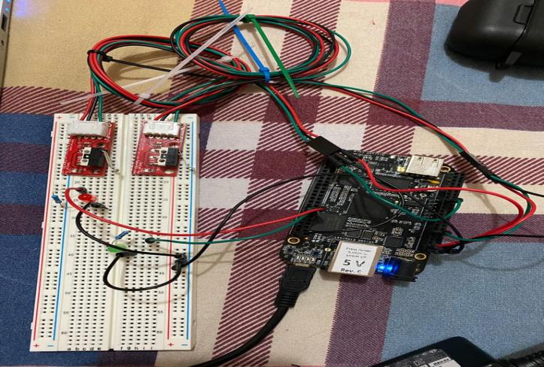

Slide 19
Function of limit switches
In our project, we are using two limit switches one is for opening the door and the other one is closing the door.
LM switch open - when we press it the pin of limit switch will go low and the output at terminal will appear as door is open.
LM switch close - when we press it the pin of limit switch will go low and the output at terminal will appear as door is closed.

Slide 20
Code
#include <iobb.h> //includes GPIO I/O header files
#include <stdio.h> //includes standard I/O header files
#include <unistd.h> //includes POSIX API library for adding delay in operations
#define GreenLED 8,16 //Green led connected to pin 16 of header P8
#define RedLED 8,15 //Red led connected to pin 15 of header P8

Slide 21
Cont.
#define LMcheckDoorOpened 9,30 //Limit switch for door open connected to pin 30 of header 9
#define LMcheckDoorClosed 9,12 //Limit switch for door close connected to pin 12 of header 9
int main(void) // main function
{
iolib_init(); // initializing GPIO I/O library
iolib_setdir(GreenLED, DigitalOut); //setting GPIO pin for Output
iolib_setdir(RedLED, DigitalOut);

Slide 22
Cont.
iolib_setdir(LMcheckDoorOpened, DigitalIn); //setting GPIO pin for Input
iolib_setdir(LMcheckDoorClosed, DigitalIn);
while(1) //continuous loop
{
if (is_low(LMcheckDoorOpened)) //if pin 30 of header is low
{
printf("Door is open \n"); //print on terminal
pin_high(RedLED); //Red LED will glow
usleep(1200000); //delay operation
}

Slide 23
Cont.
else if (is_high(LMcheckDoorOpened)) //if pin 30 of header is high
{
pin_low(RedLED); //Red LED will not glow
}
if (is_low(LMcheckDoorClosed)) // if pin 12 of header is low
{
printf("Door is Closed \n");
pin_high(GreenLED); //LED will glow
usleep(1200000);
}

Slide 24
Cont.
else if (is_high(LMcheckDoorClosed)) //if pin 12 of header is high
{
pin_low(GreenLED); // LED will not glow
}
}
iolib_free(); //end of program (freed library resources)
return(0); //return a value
}

Slide 25
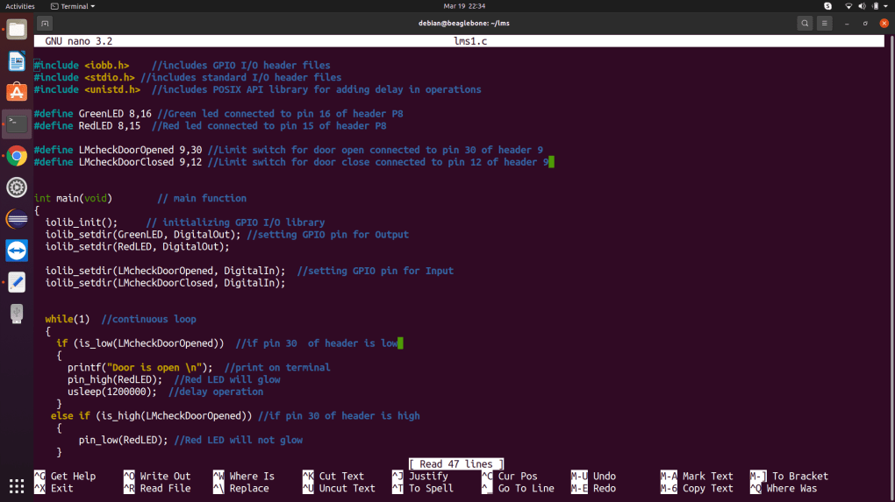

Slide 26
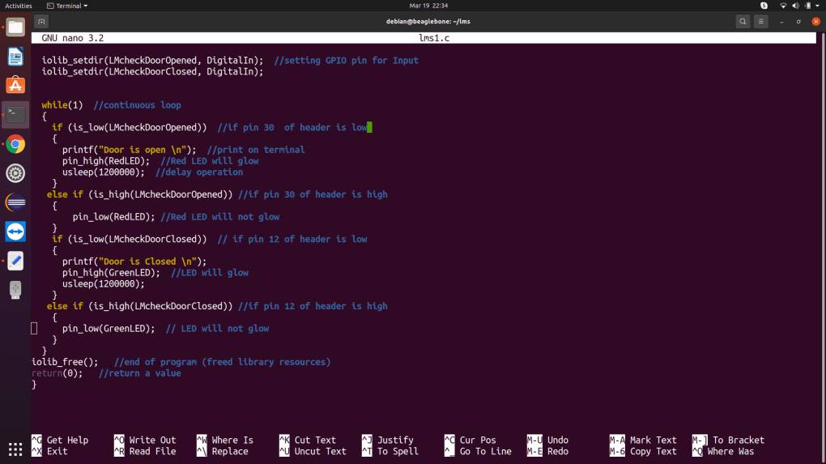

Slide 27
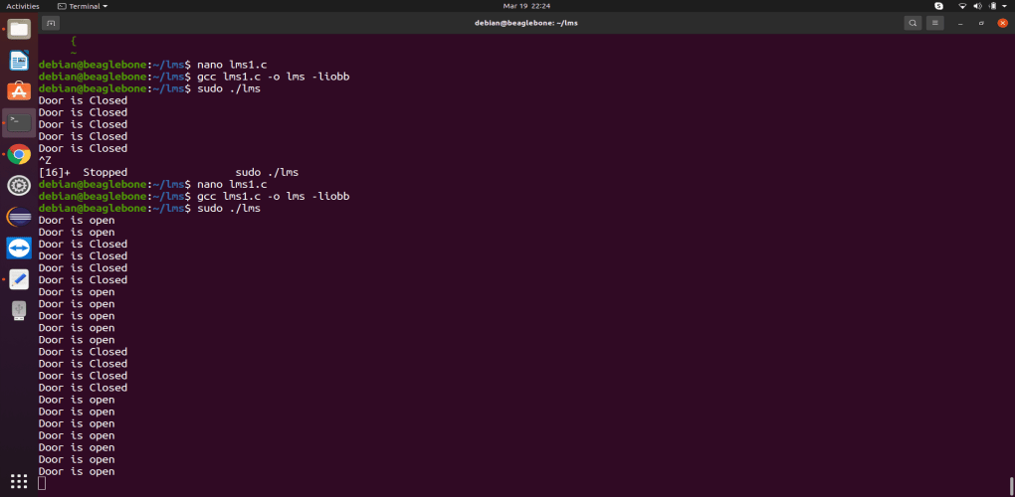
Terminal Output

Slide 28
References
Retrieved from components101.com, Beaglebone black (2018, july 09)
URL:https://components101.com/microcontrollers/beaglebone-black-pinout-datasheet
Retrieved from thomasnet.com, Limit switch characterstics
URL: https://www.thomasnet.com/articles/instruments-controls/limit-switches/
Retrieved from youtube.com, working of limit switch
URL: http://youtube.com/watch?v=q6nP1FjxAMU
Retrieved from man7.org, usleep linux manual
URL: https://man7.org/linux/man-pages/man3/usleep.3.html

Slide 29
Cont.
Retrieved from amazon.ca, limit switch
URL:https://www.amazon.ca/dp/B071JV158X/ref=cm_sw_r_wa_apa_i_T4SVA1ZN2XH2E1WKM99N
Retrieved from element14.com, Beagle board (2019, August 14)
URL: https://www.element14.com/community/community/designcenter/single-board-computers/next-genbeaglebone/blog/2019/08/15/beaglebone-black-bbb-io-gpio-spi-and-i2c-library-for-c-2019-edition

